Slide 1
Advanced Python Workshop
Presented By:
Ali Waheed
Ahsan Goheer

Slide 2
Workshop Outline
Session – 1
Setting up the code editor.
AutoEDA using Dtale.
Developing Web Apps using Streamlit.
Experimentation and Development of ML pipeline using PyCaret.
Session – 2
Deploying ML pipeline and Models using Fast API.
Containerization using Docker.

Slide 3
Motivation

Slide 4
Our Philosophy
“I would rather have questions that can't be answered than answers that can't be questioned.” ― Richard Feynman

Slide 5
Session - 1

Slide 6

Setting up the Code Editor

Slide 7
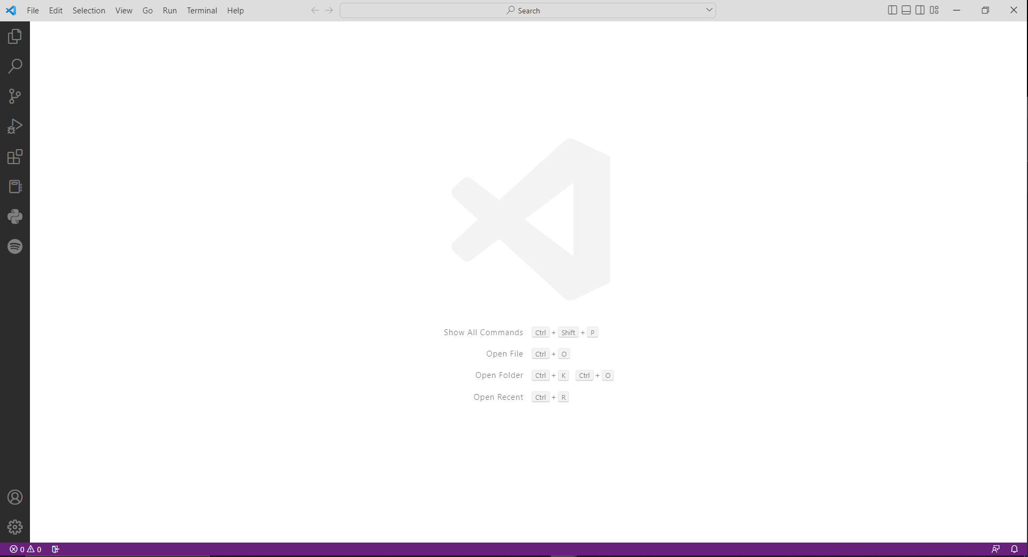
Downloading VS Code
VS Code is a free code editor that can be downloaded from https://code.visualstudio.com/
Benefits:
Lightweight.
Has an extensive library of extensions.
Highly Customizable.
Comes with version control integration options.

Slide 8
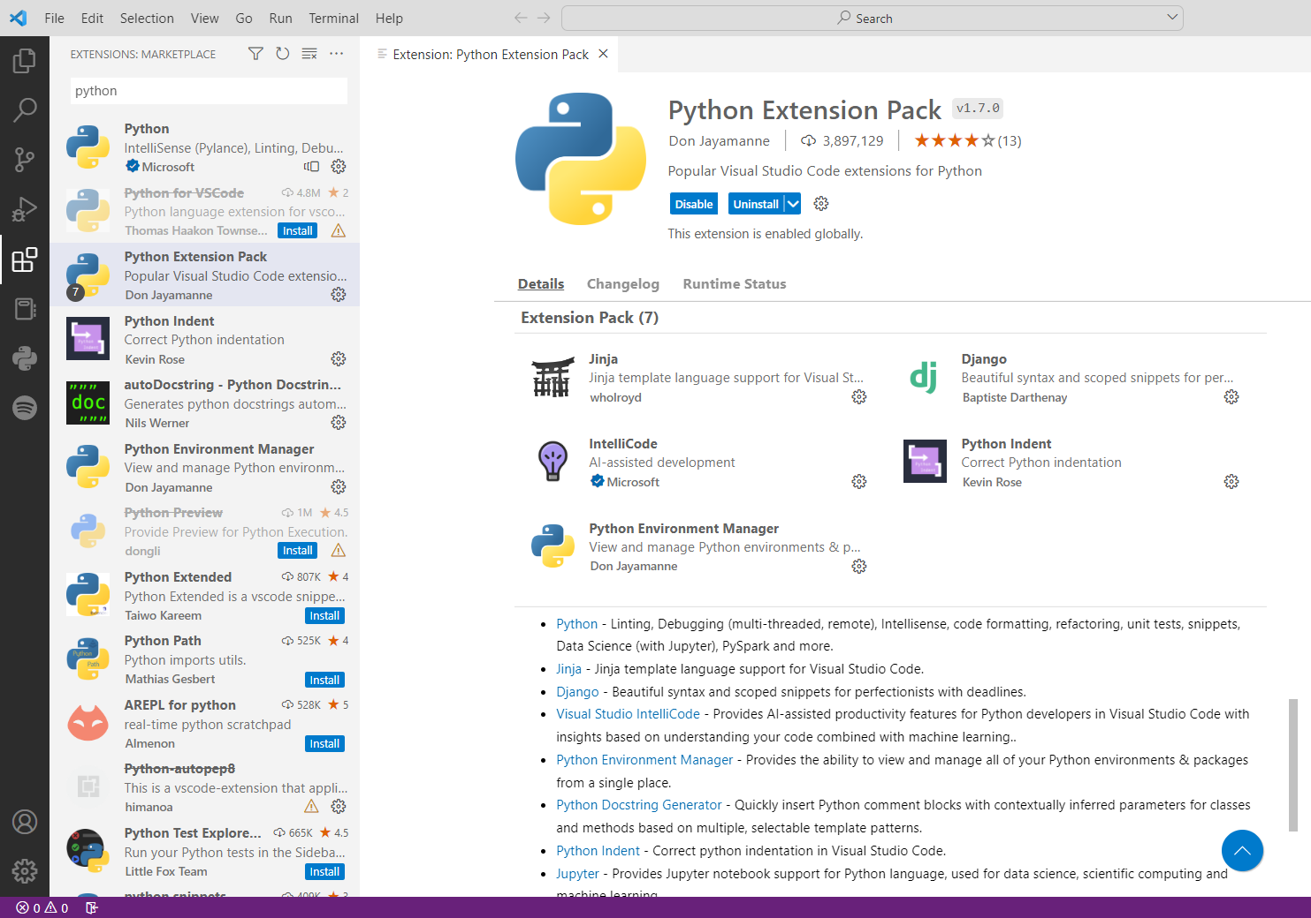
Installing Python Extensions

Slide 9
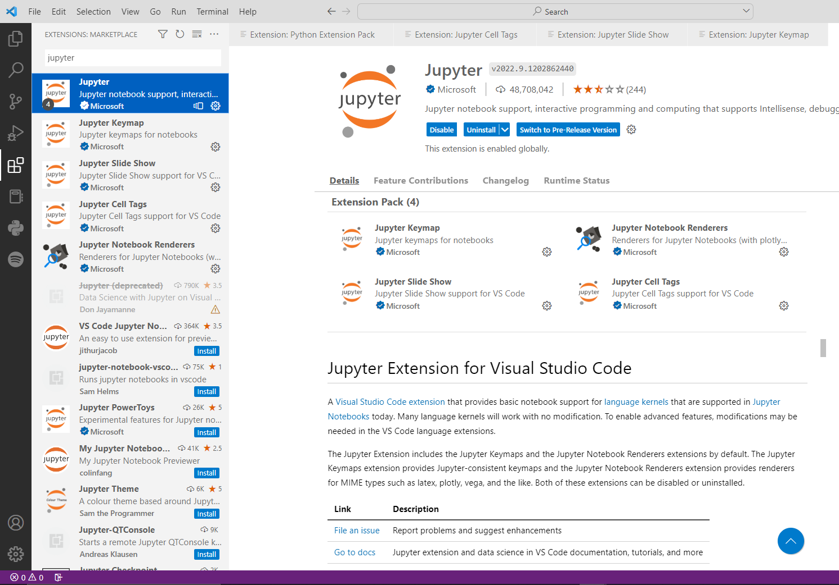
Installing Jupyter Extensions

Slide 10
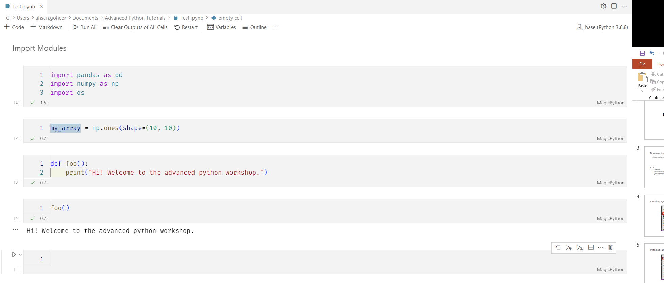
Jupyter notebooks in VS Code.

Slide 11
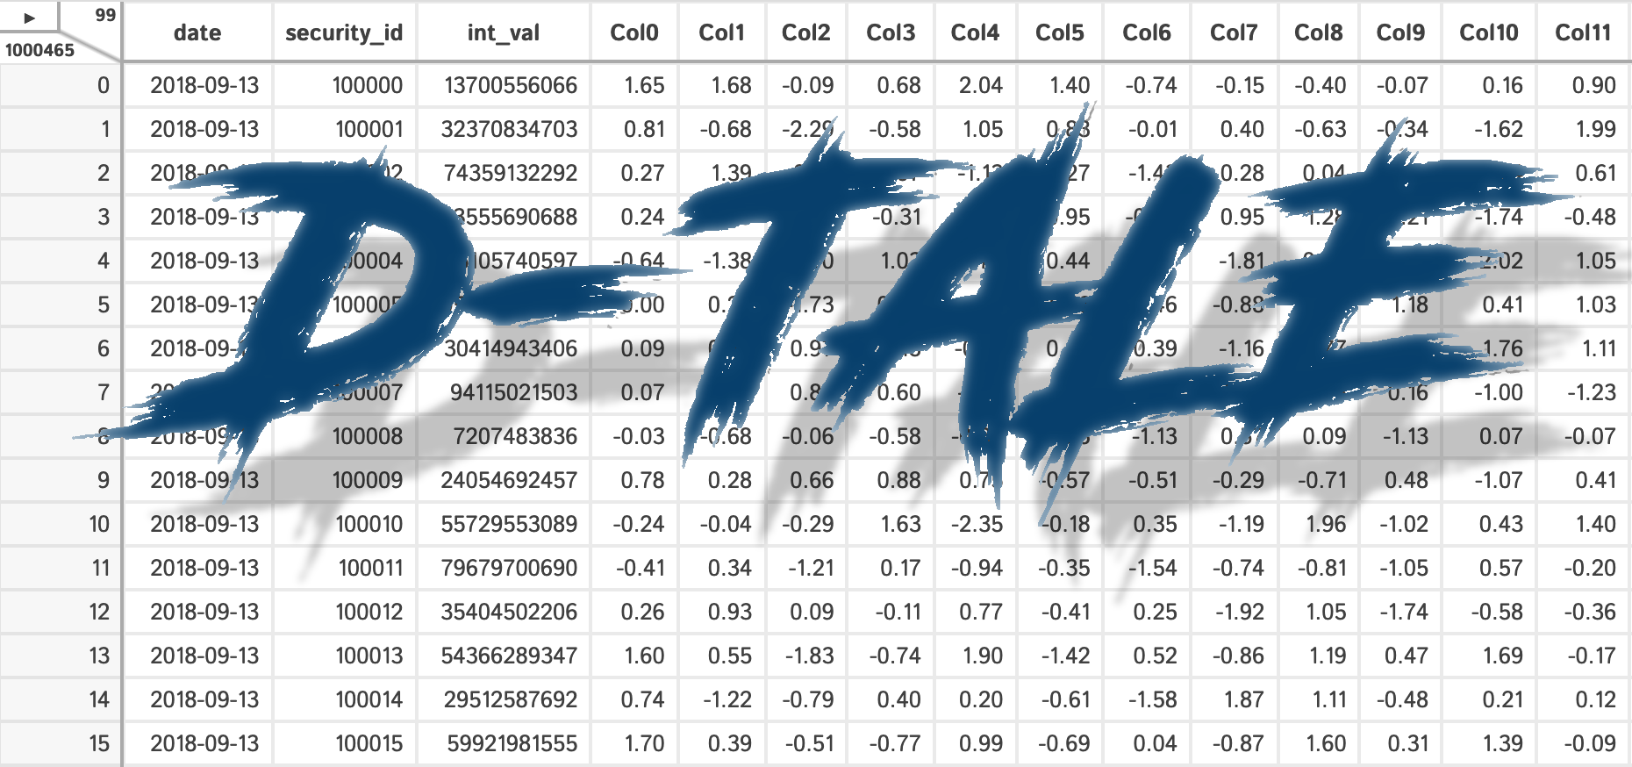
EDA using Dtale

Slide 12
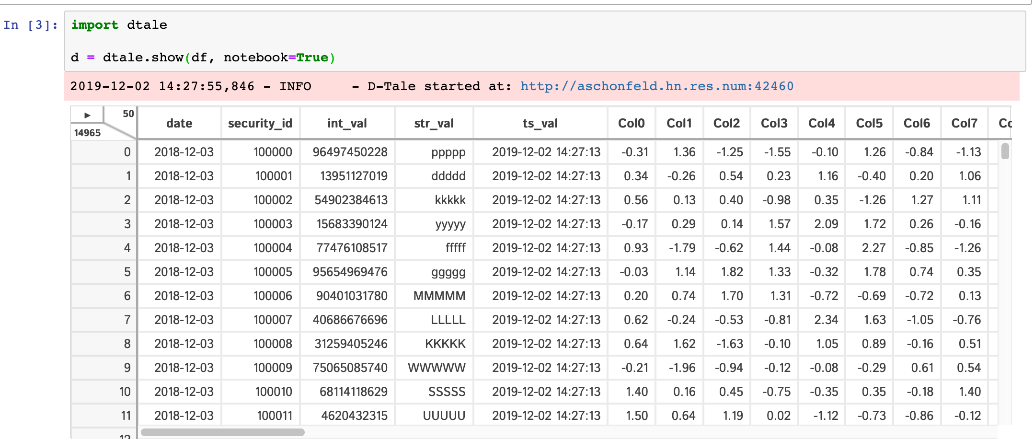
What is Dtale?
D-Tale is the combination of a Flask back-end and a React front-end to bring you an easy way to view and analyze Pandas data structures. It integrates seamlessly with Ipython notebooks and python/Ipython terminals. Currently this tool supports such Pandas objects as DataFrame, Series, MultiIndex, DatetimeIndex and RangeIndex.

Slide 13
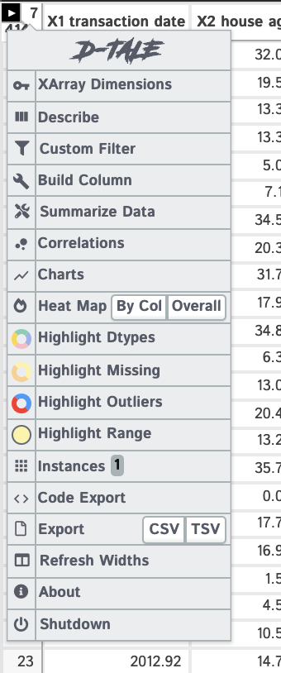
Why use Dtale?
Simple and easy to use.
No-code analysis environment.
Generates pandas and plotly code to recreate operations in a different environment.
Helps expedite EDA by flattening the learning curve for pandas or other EDA packages.

Slide 14
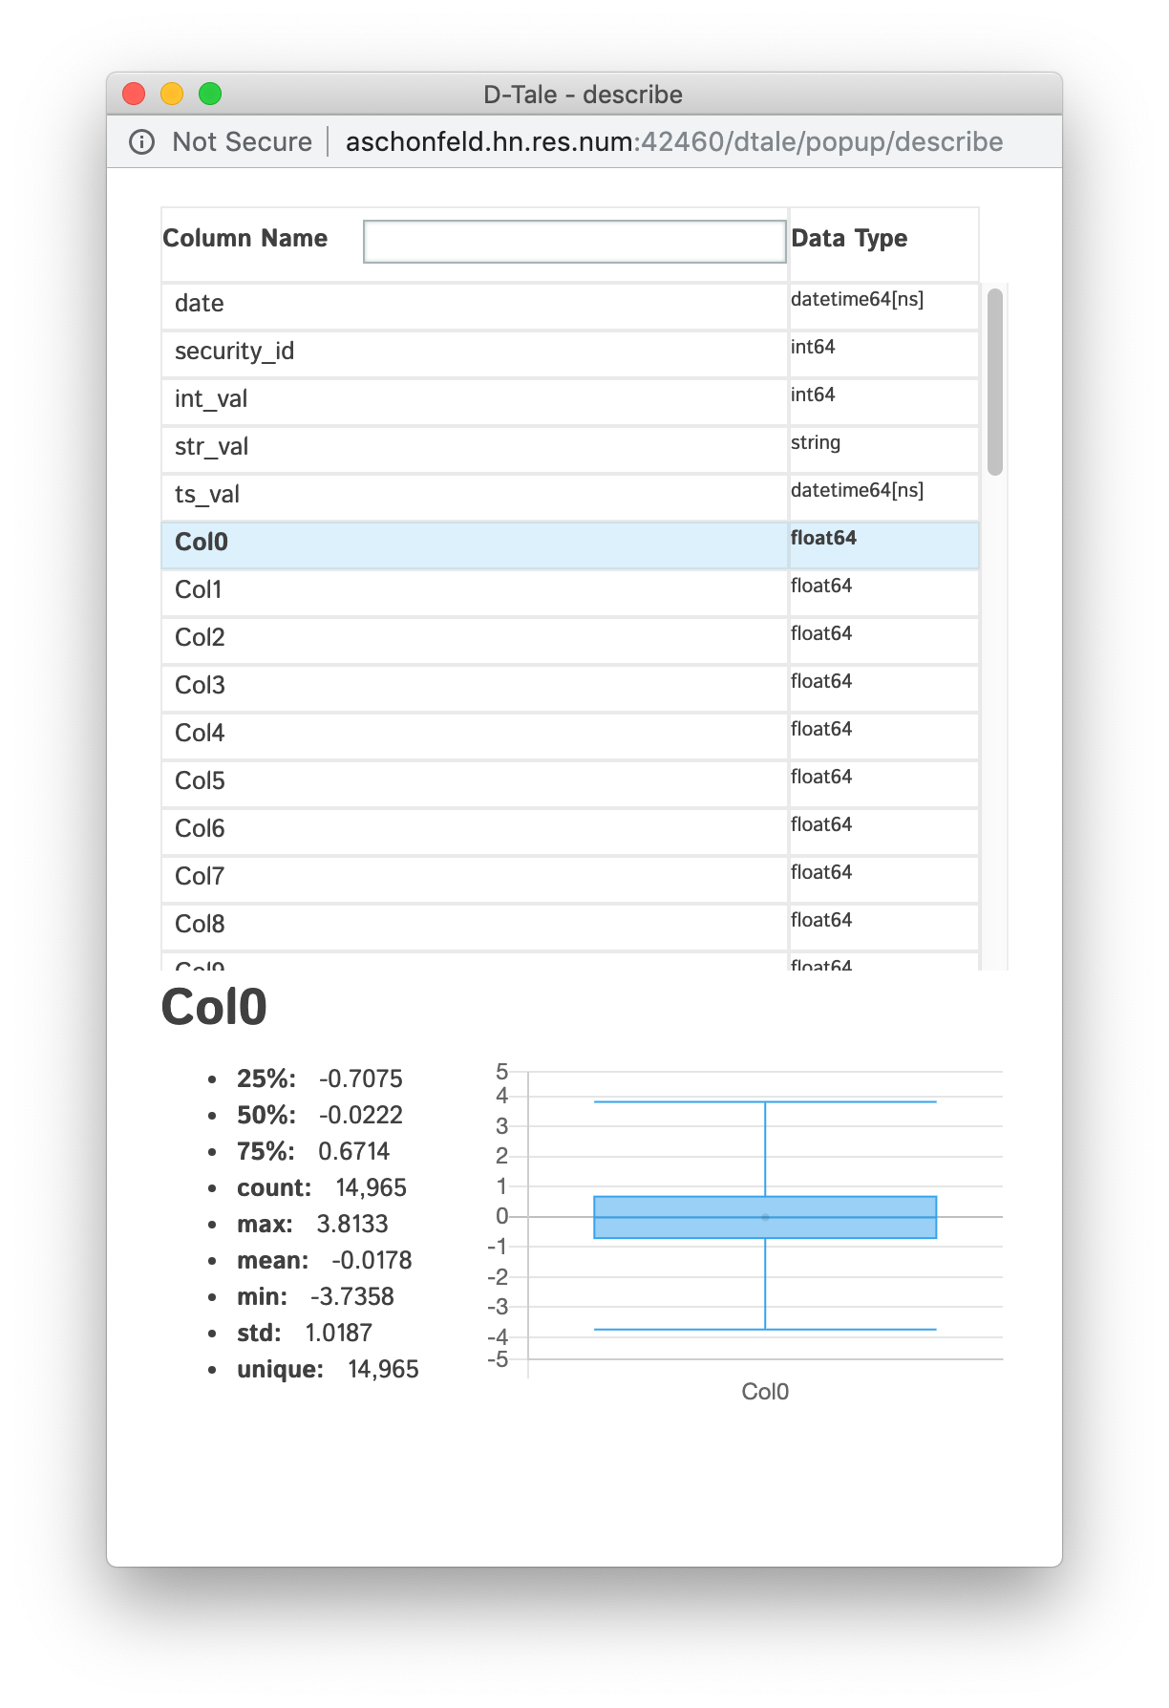
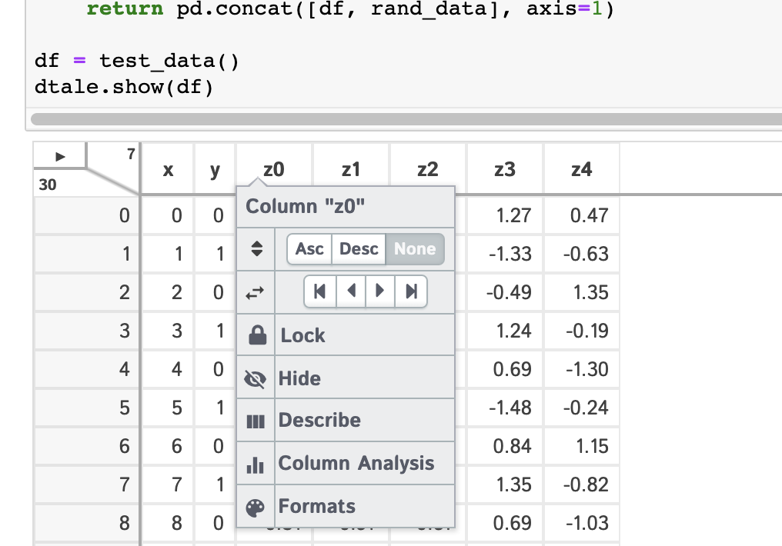
Things you can do with Dtale.

Slide 15
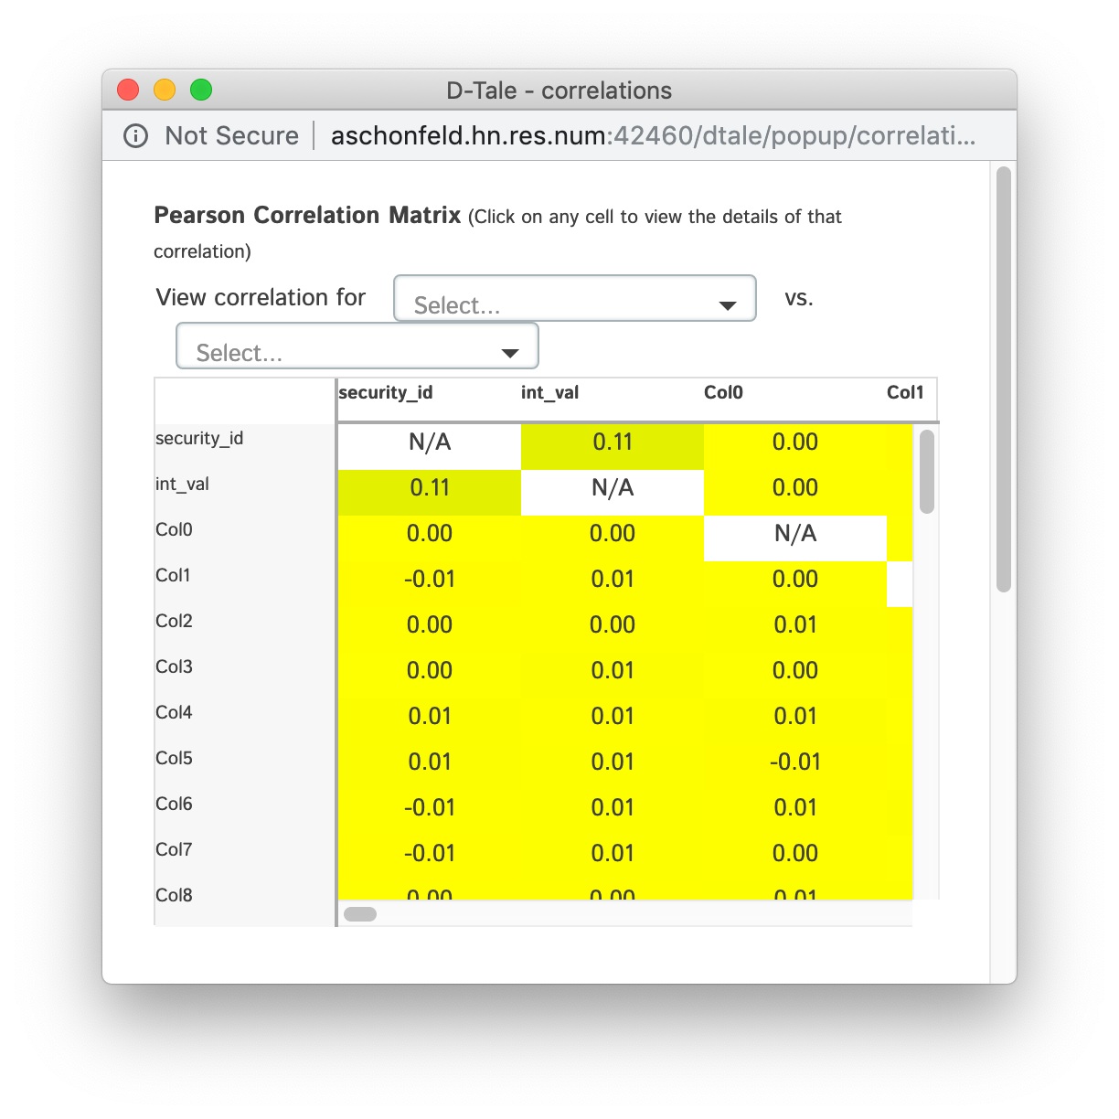
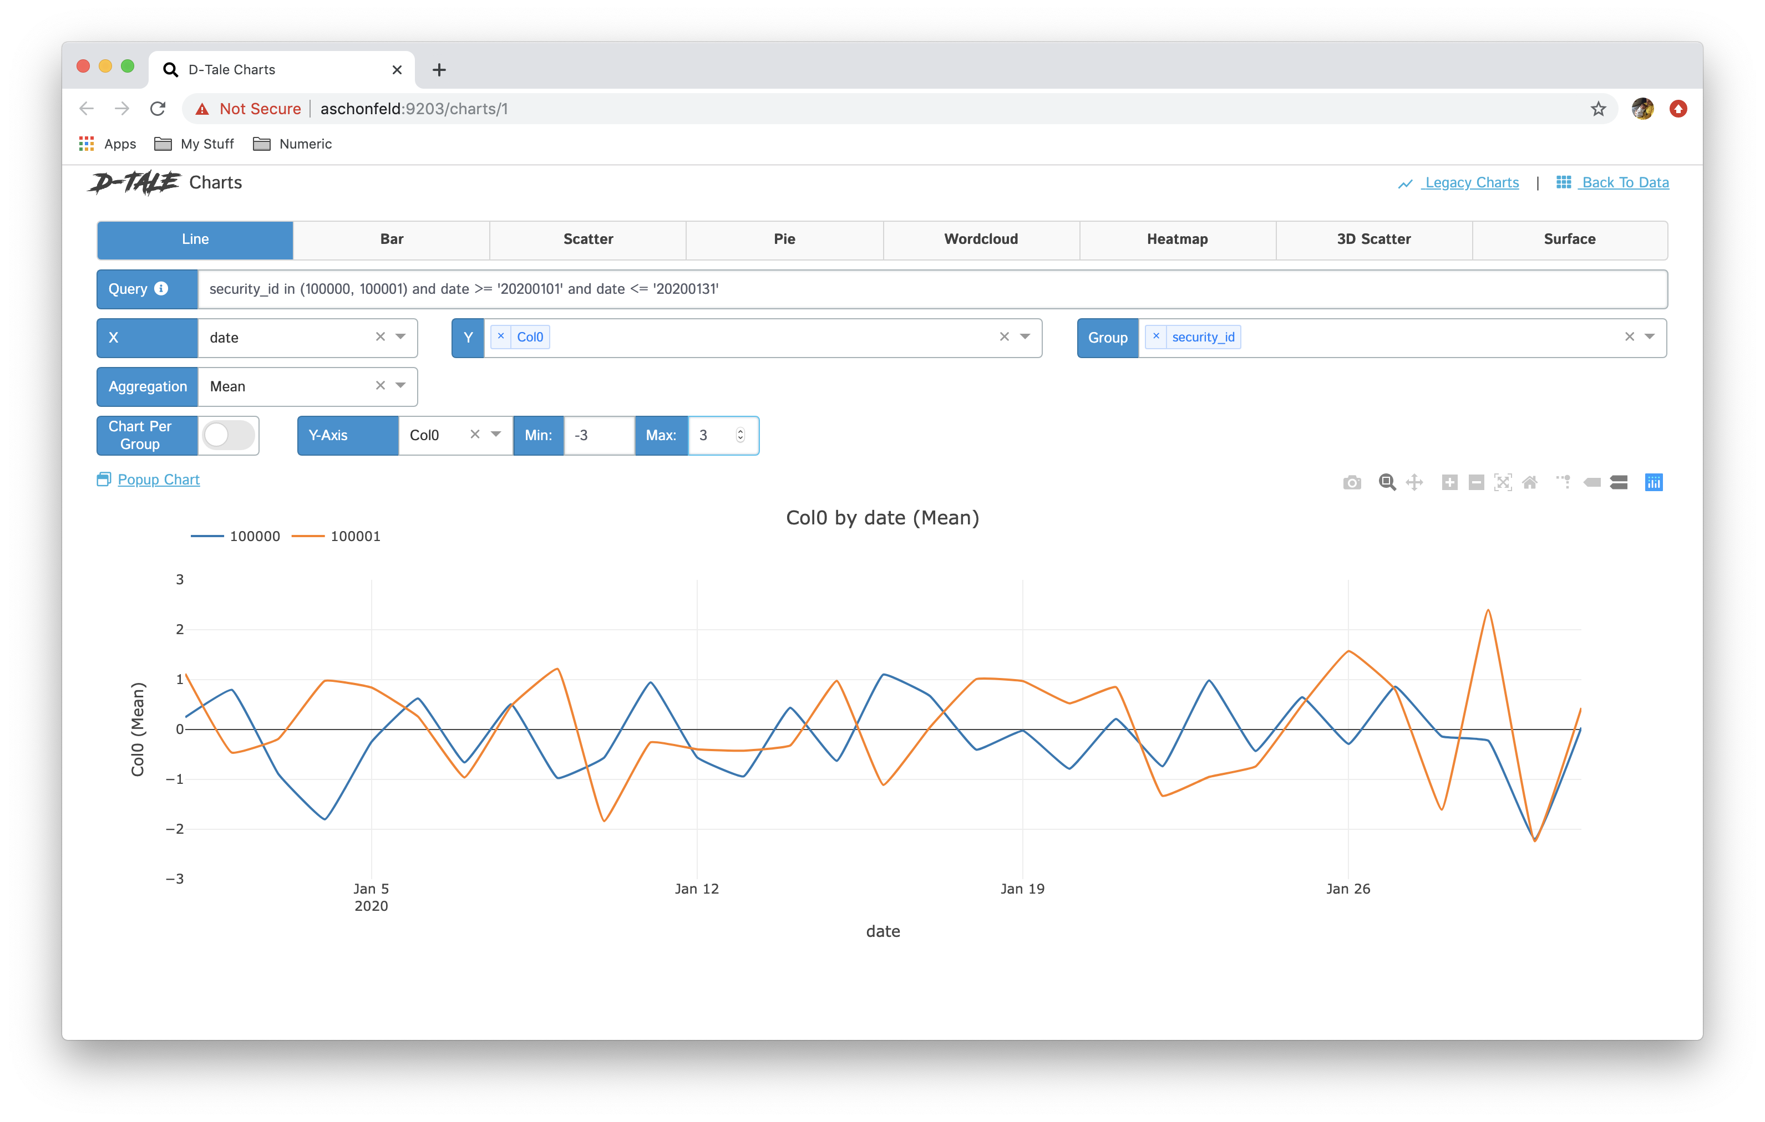
Things you can do with Dtale.

Slide 16
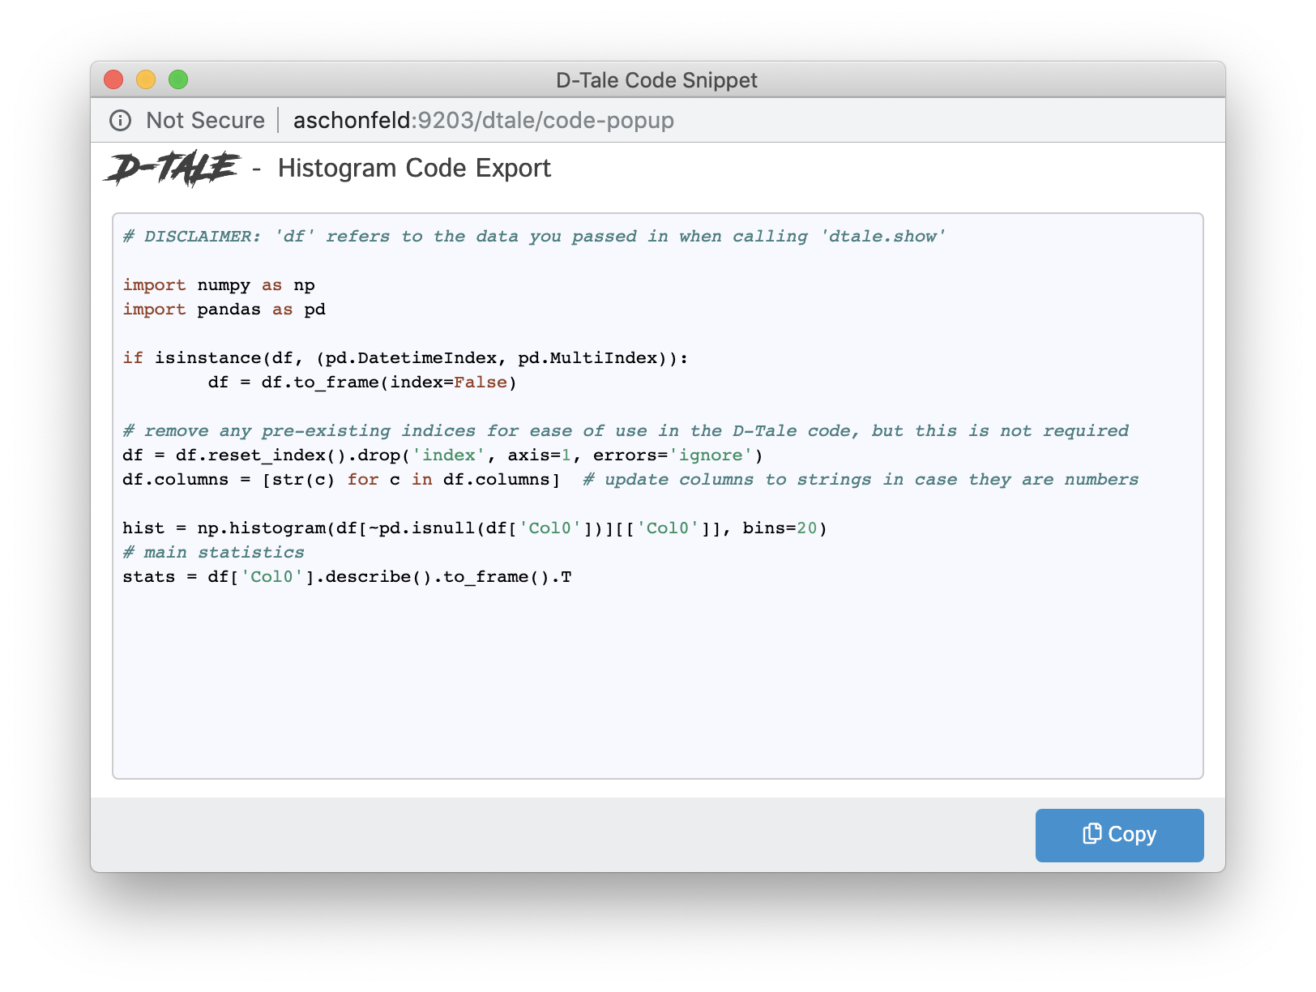
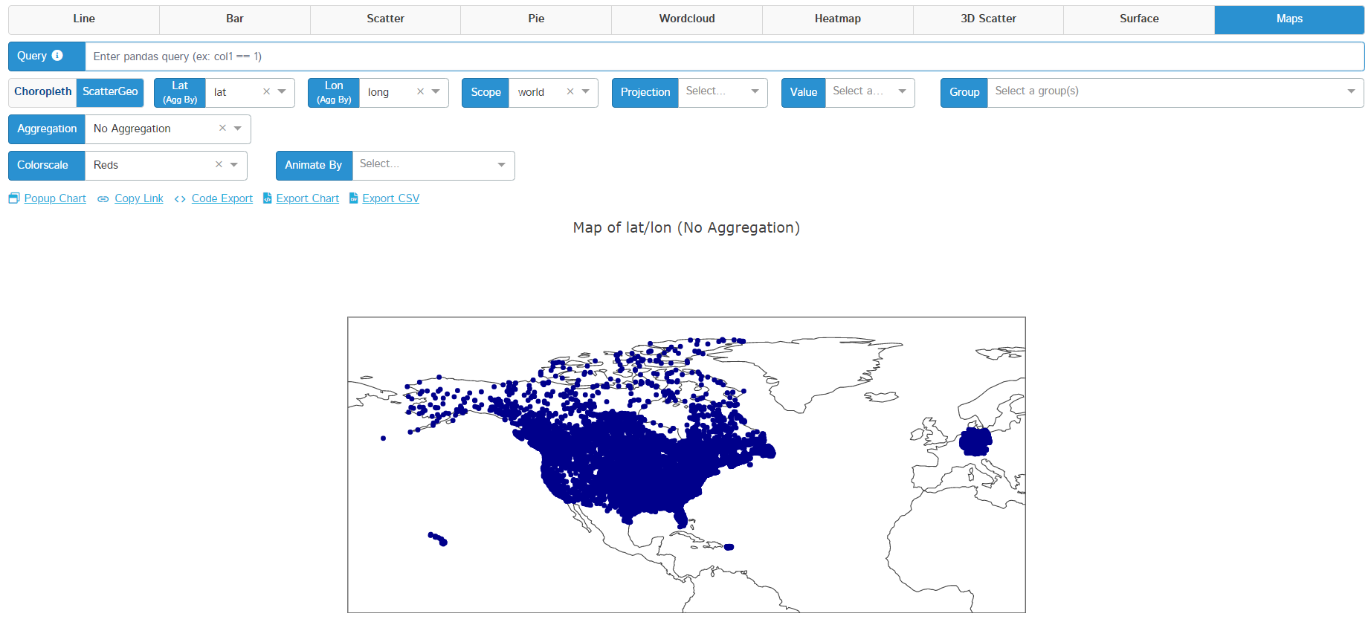
Things you can do with Dtale.

Slide 17
Demo

Slide 18

Creating Web Apps with Streamlit

Slide 19
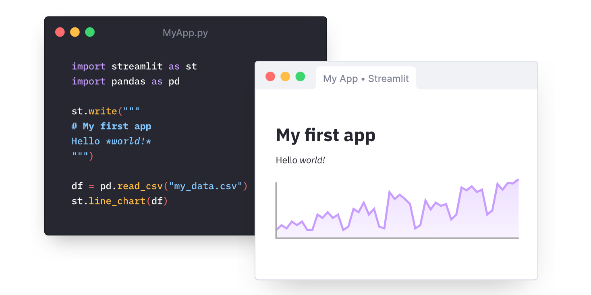
What is Streamlit?
Streamlit is an open-source python framework for building web apps for Machine Learning and Data Science. We can instantly develop web apps and deploy them easily using Streamlit. Streamlit allows you to write an app the same way you write python code.

Slide 20
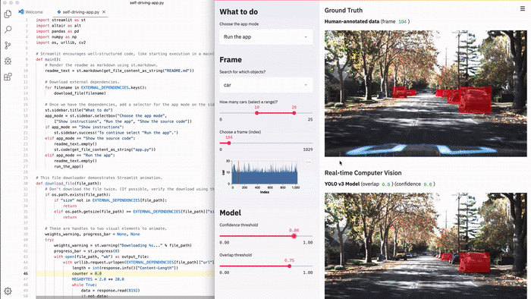
Why use Streamlit?
Simple and intuitive to use.
A flexible and quick development flow.
Allows reusability of python code.
Supports all the popular databases and APIs.
Easy to follow documentation.
A very active open-source community.

Slide 21
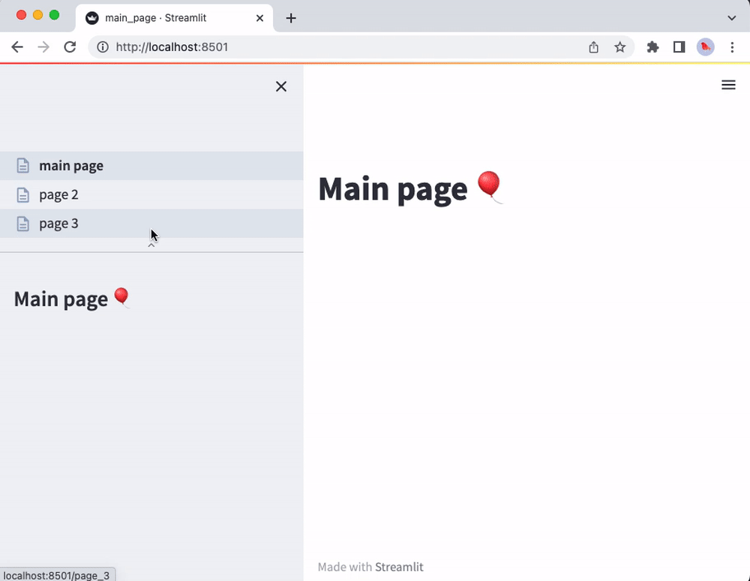
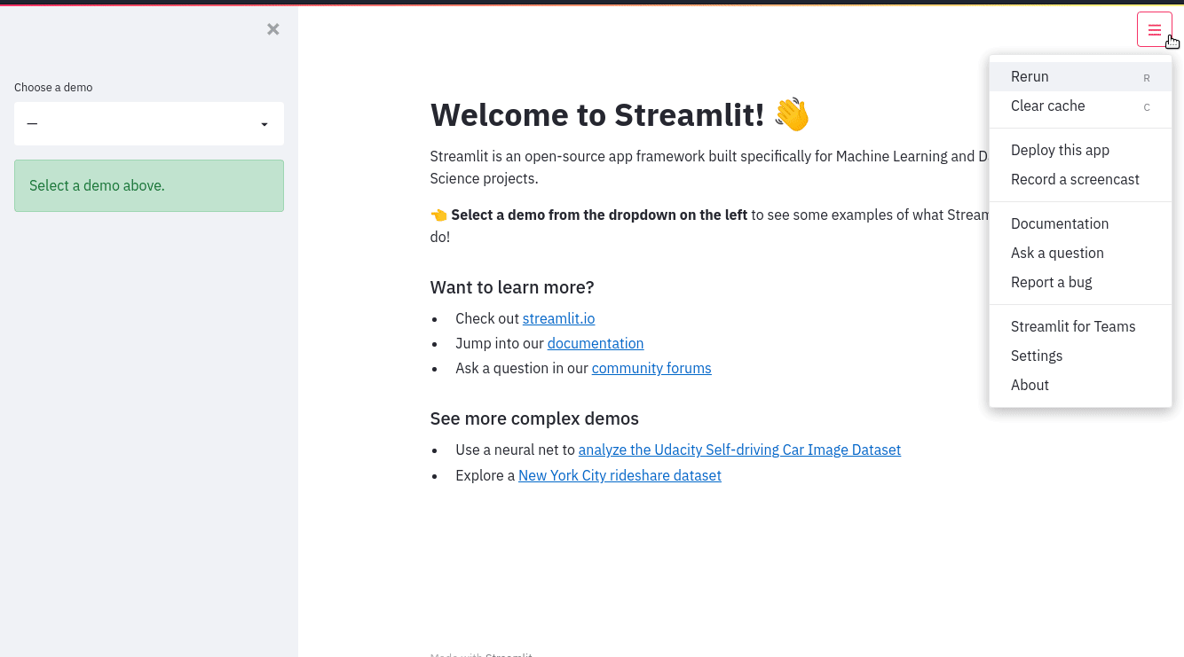
Things you can do with Streamlit
Create single and multi-page applications.

Slide 22
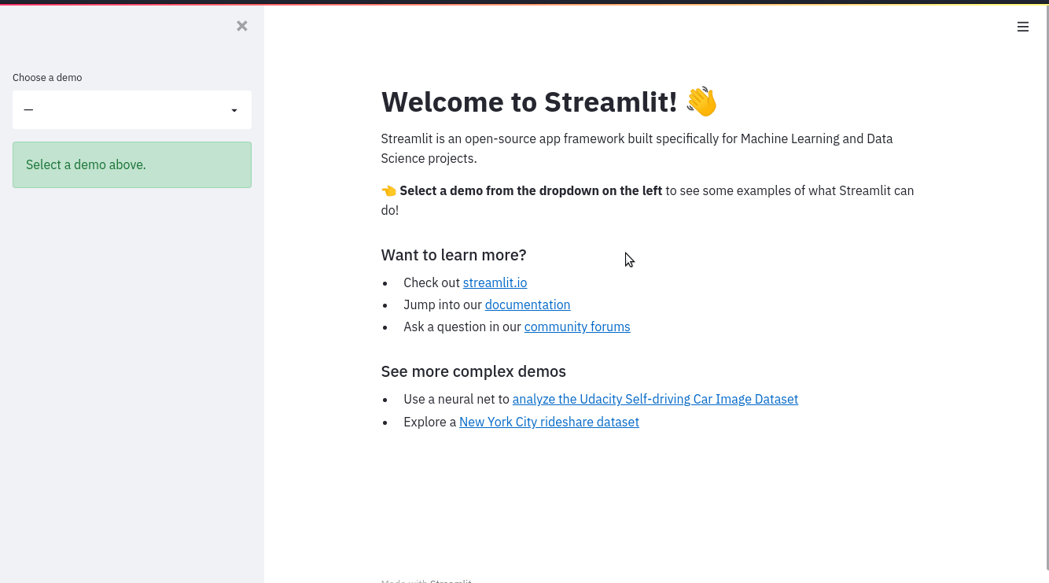
Things you can do with Streamlit
Customize the application without needing knowledge of front-end development.

Slide 23
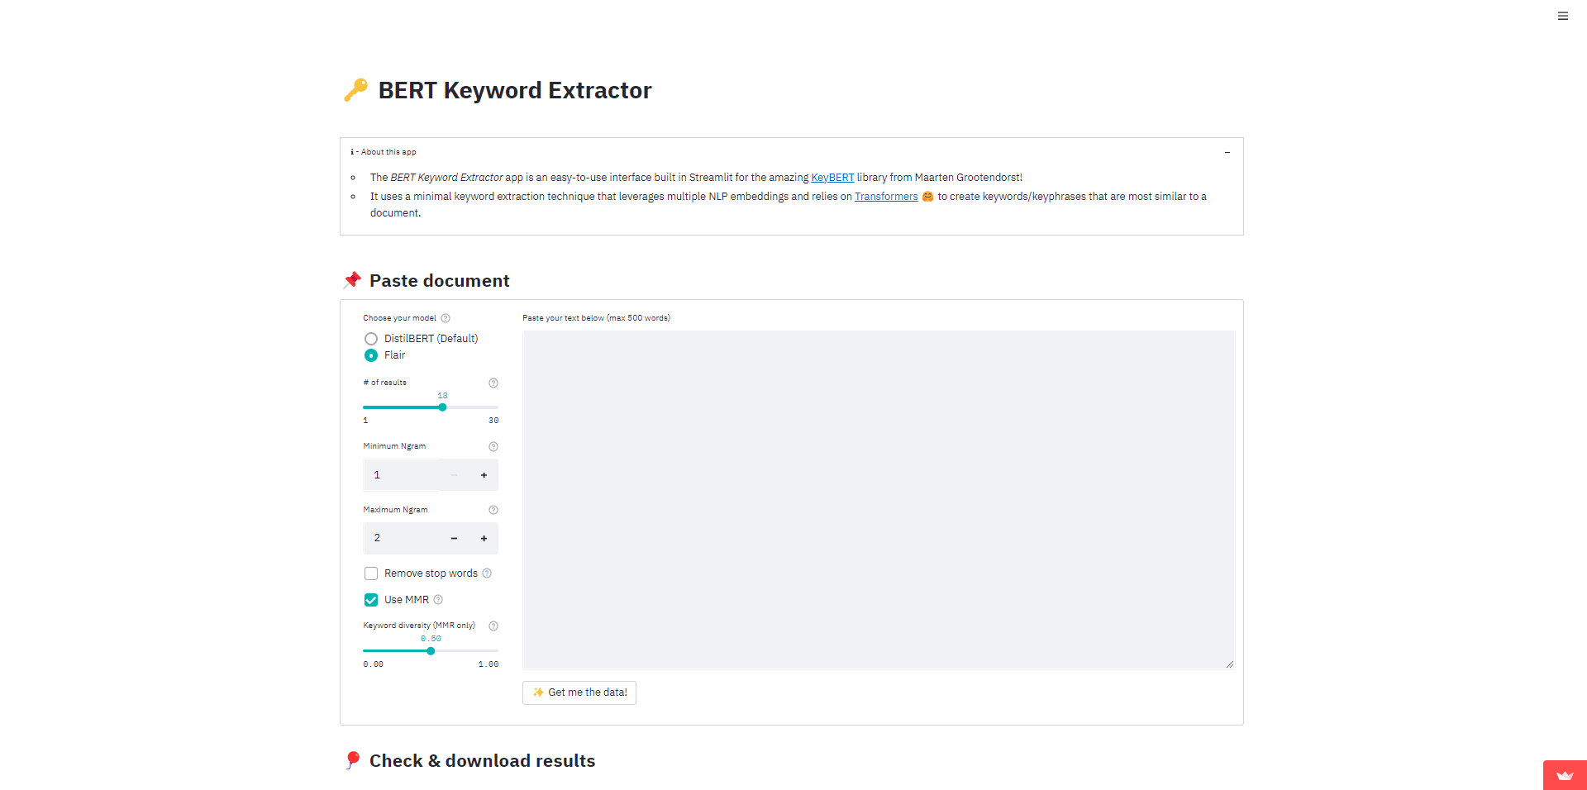
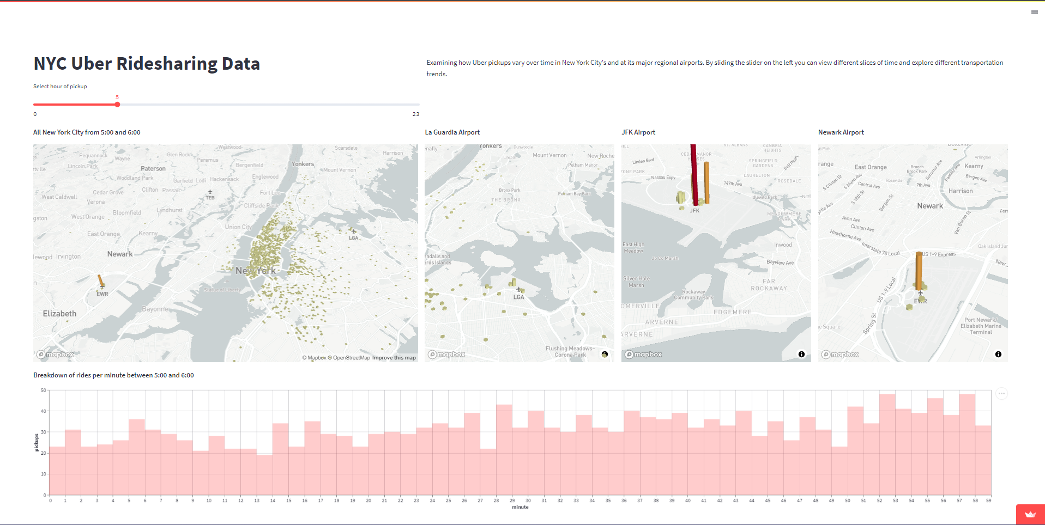
Things you can do with Streamlit
Create visually stimulating charts and graphics and deploy them in the form of a web app for your client.

Slide 24
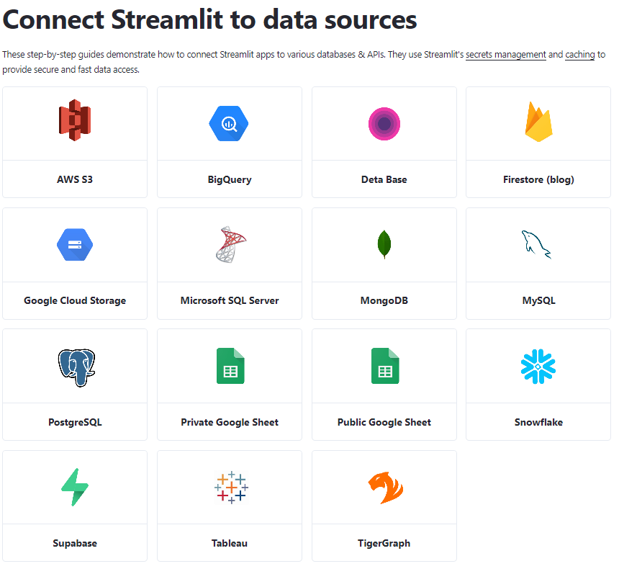
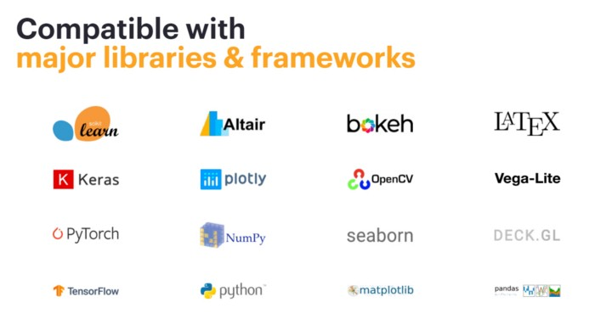
Things you can do with Streamlit
Use popular frameworks and libraries with Streamlit to create sophisticated applications.

Slide 25
Demo

Slide 26

Modeling and Experimentation with PyCaret

Slide 27
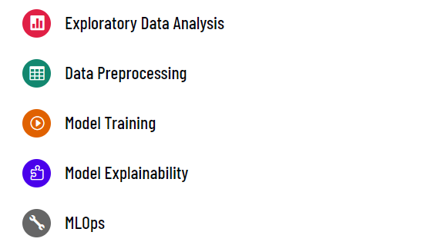
What is PyCaret?
PyCaret is an open-source, low-code machine learning library in Python that automates machine learning workflows. It is an end-to-end machine learning and model management tool that exponentially speeds up the experiment cycle and makes you more productive.

Slide 28
Why use PyCaret?
It is a low-code and fast modeling solution.
Great for running rapid experimentation and analyzing feature importance.
It is a deployment-ready library with reproducible pipeline results.

Slide 29
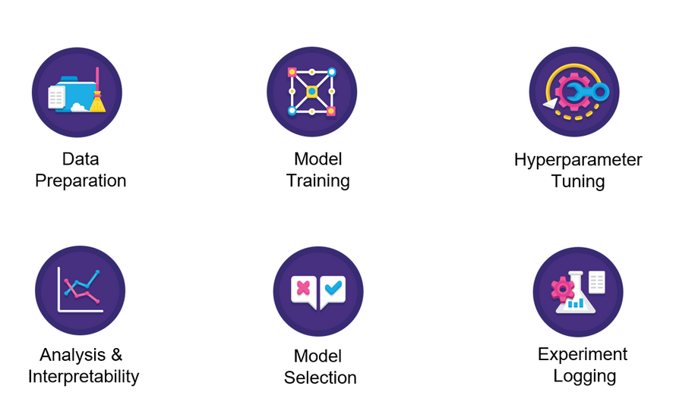
Things you can do with PyCaret
Run an end-to-end ML Pipeline for experimentations that can easily be deployed.

Slide 30
Things you can do with PyCaret
Classification
Regression
Clustering
NLP
Anomaly Detection
Time Series (Beta)
Run an end-to-end ML Pipeline for experimentations that can easily be deployed.

Slide 31
Demo

Slide 32
Questions ?

Slide 33
Session - 2

Slide 34
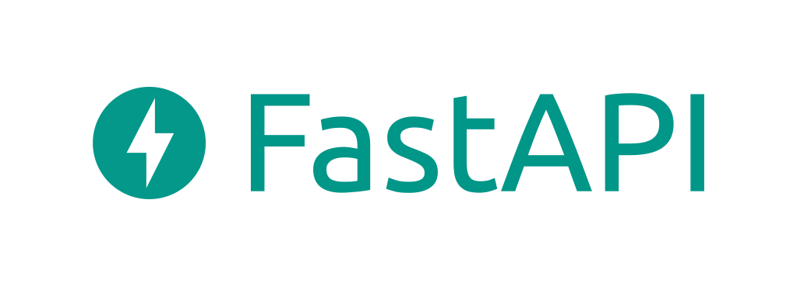
Deploying ML pipeline and Models

Slide 35


Where is AI used mostly?
Utilities/Energy
Healthcare & Lifesciences
Agriculture & Biosciences
Transportation & Logistics
etc.

Slide 36
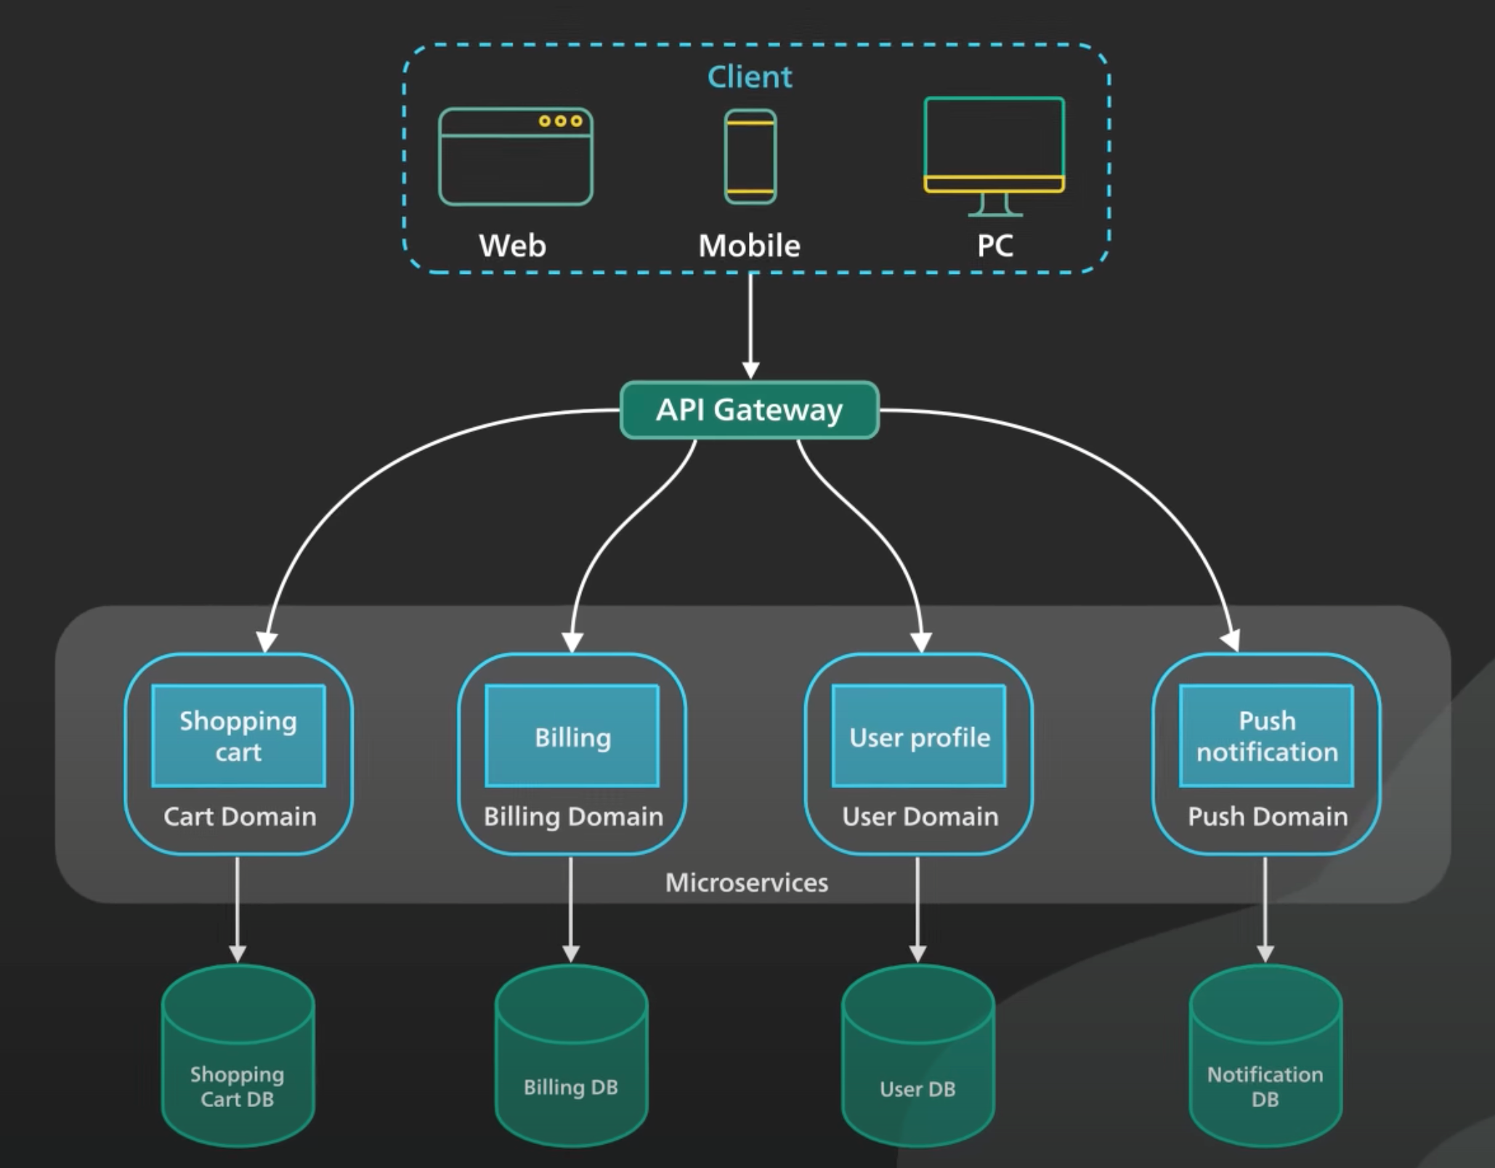
What makes a service, Microservice?
Small
Focused on One Task
Aligned with a Bounded Context
Autonomous
Independently Deployable
Loosely-Coupled

Slide 37
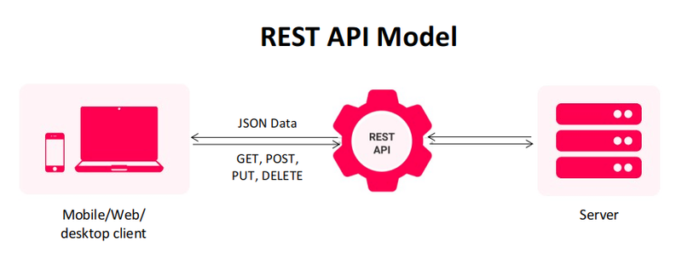
REpresentational State Transfer – Application Programming Interface

Slide 38
Demo

Slide 39
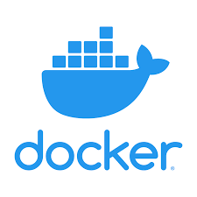
Containerization using Docker

Slide 40
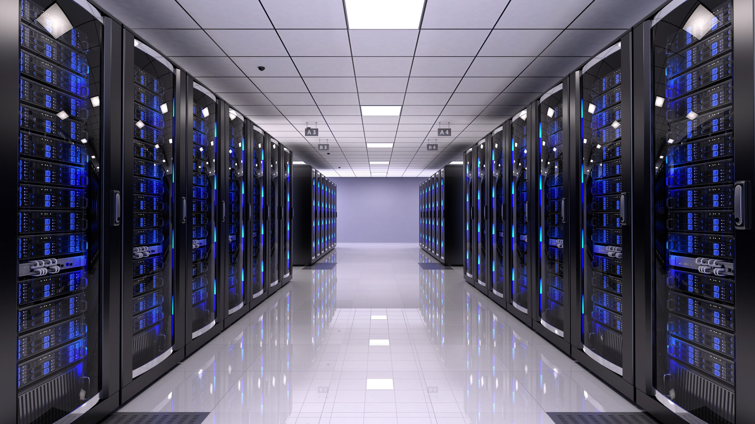
A Problem in the 60’s !
One IP to rule them all !

Slide 41
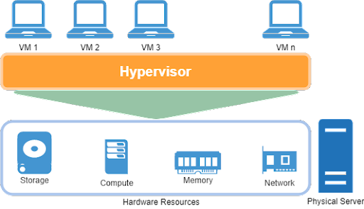
Benefits of a Virtual Machine (VM)
Cost Savings (Energy + Hardware)
Easy provisioning
Easy Disaster Recovery
Smaller Foot Print
Run multiple OS

Slide 43
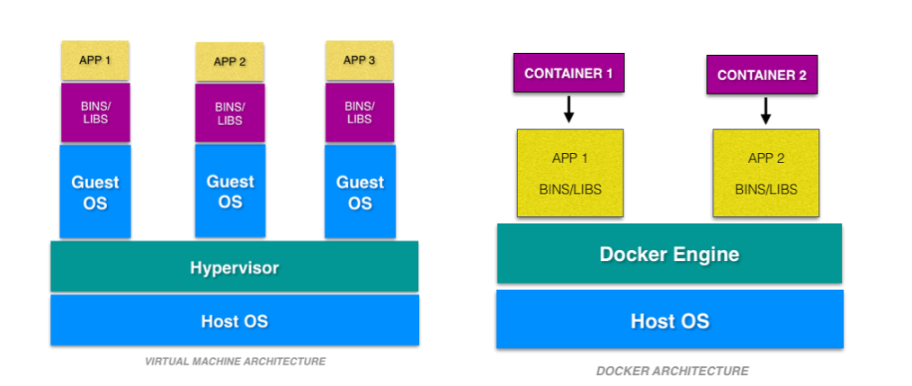
VM vs Docker … is this a zero-sum game?

Slide 44
Demo

Slide 45
Thanks !

